Slide 1
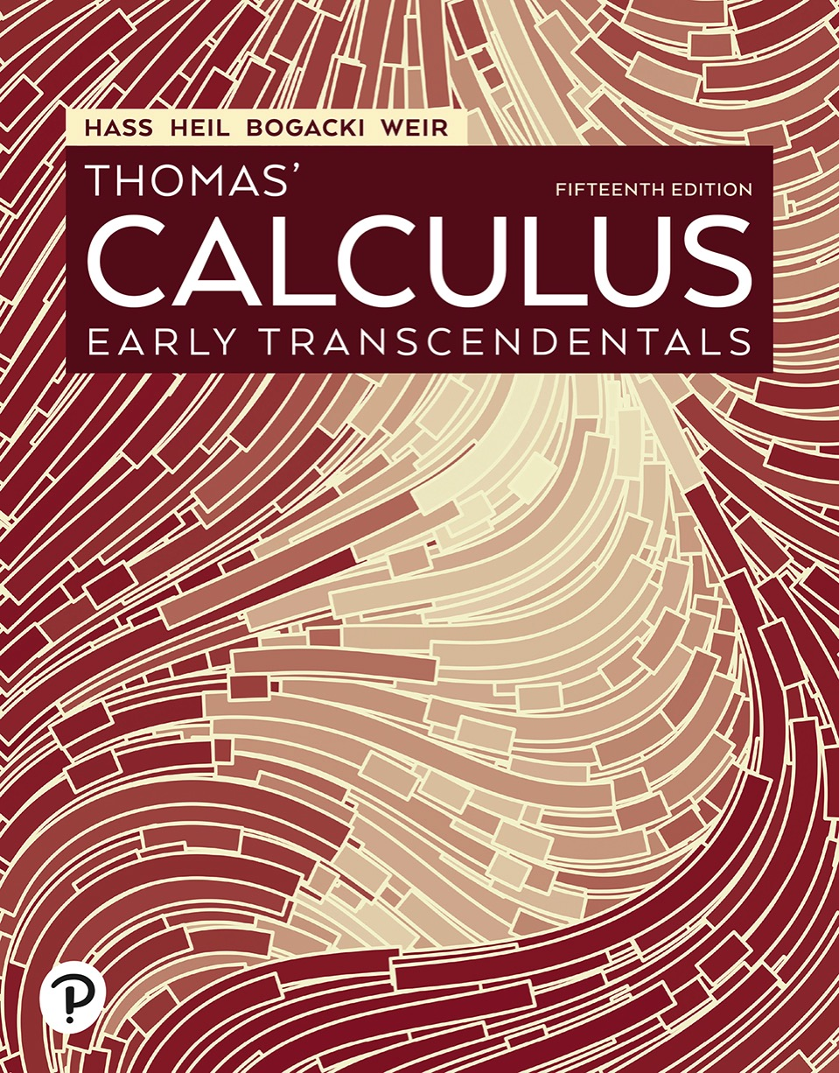

Thomas’ Calculus: Early Transcendentals
Fifteenth Edition
Chapter 14
Partial Derivatives
Copyright © 2023, 2018, 2014 Pearson Education, Inc. All Rights Reserved
Notes:
If this PowerPoint presentation contains mathematical equations, you may need to check that your computer has the following installed:
1) MathType Plugin
2) Math Player (free versions available)
3) NVDA Reader (free versions available)

Slide 2
Section 14.3 Partial Derivatives

Slide 3
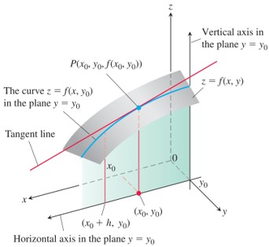
Partial Derivatives of a Function of Two Variables (1 of 5)
The intersection of the plane
with the
surface
viewed from above the first
quadrant of the x y-plane.
Notes:
The vertical axis is labeled, vertical axis in the plane y = y sub 0. The horizontal axis is labeled, horizontal axis in the plane y = y sub 0. The surface labeled, z = ƒ of x and y, intersects the plane. The curve in the plane is labeled, the curve z = f of x and y sub 0 in the plane y = y sub 0. The curve is projected on the horizontal axis in the plane, forming two points (x sub 0, y sub 0) and (x sub 0 + h, y sub 0). A tangent line drawn on the surface meets the curve at point, P, left parenthesis x sub 0, y sub 0, f of x sub 0 and y sub 0 right parenthesis.

Slide 4
Partial Derivatives of a Function of Two Variables (2 of 5)
Definition: The partial derivative of
with respect to x at the point
is
provided the limit exists.

Slide 5
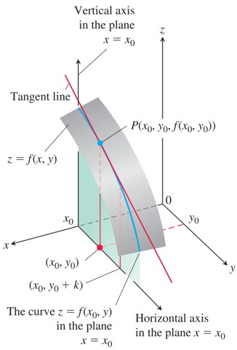
Partial Derivatives of a Function of Two Variables (3 of 5)
The intersection of the plane
with the surface
viewed from
above the first quadrant of the x y-plane.
Notes:
The vertical axis is labeled, vertical axis in the plane x = x sub 0. The horizontal axis is labeled, horizontal axis in the plane x = x sub 0. The surface labeled, z = ƒ of x and y, intersects the plane. The curve in the plane is labeled, the curve z = f of x sub 0 and y in the plane x = x sub 0. The curve is projected on the horizontal axis in the plane, forming two points, (x sub 0, y sub 0) and (x sub 0, y sub 0 + k). A tangent line drawn on the surface meets the curve at point, P, left parenthesis x sub 0, y sub 0, f of x sub 0 and y sub 0 right parenthesis.

Slide 6
Partial Derivatives of a Function of Two Variables (4 of 5)
Definition: The partial derivative of
with respect to y at the point
is
provided the limit exists.

Slide 7
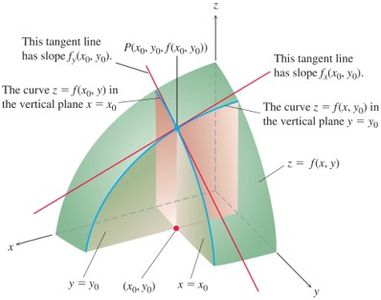
Partial Derivatives of a Function of Two Variables (5 of 5)
The Figures combined. The tangent lines at the point
determine a plane that, in this picture at
least, appears to be tangent to the surface.
Notes:
Two curves are drawn on the surface. The first curve is labeled, the curve z = f of x sub 0 and y in the vertical plane x = x sub 0. The second curve is labeled, the curve z = f of x and y sub 0 in the vertical plane y = y sub 0. Two tangents to the surface intersect at point, P, left parenthesis x sub 0, y sub 0, f of x sub 0 and y sub 0 right parenthesis. The projection of this intersection point meets the horizontal axis at point (x sub 0, y sub 0). The first tangent line is labeled, this tangent line has slope f sub y of x sub 0 and y sub 0. The second tangent line is labeled, this tangent line has slope f sub y of x sub 0 and y sub 0.

Slide 8
Calculations (1 of 9)
Example: Find the values of
at the point
if
Solution: To find
we treat y as a constant and
differentiate with respect to x:
The value of
at

Slide 9
Calculations (2 of 9)
Solution (concluded):
To find
we treat x as a constant and
differentiate with respect to y:
The value of
at

Slide 10
Calculations (3 of 9)
Example: Find
as functions if
Solution: We treat f as a quotient. With y held constant, we use the quotient rule to get

Slide 11
Calculations (4 of 9)
Solution (concluded):
With x held constant and again applying the quotient rule, we get

Slide 12
Calculations (5 of 9)
Example: Find
assuming that the equation
defines z as a function of the two independent variables x and y and the partial derivative exists.
Solution: We differentiate both sides of the equation with respect to x, holding y constant and treating z as a differentiable function of x:

Slide 13
Calculations (6 of 9)
Solution (concluded):

Slide 14
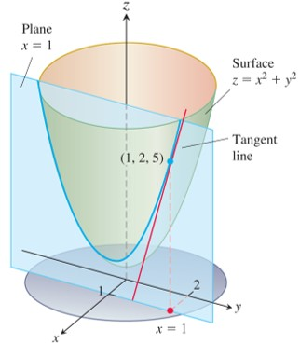
Calculations (7 of 9)
The tangent to the curve of intersection of the plane
x = 1 and surface
at the point (1, 2, 5).
Notes:
The parabola is formed at the region of intersection of a paraboloid with a plane. The plane is labeled, x = 1. The surface of the paraboloid is labeled, z = x squared + y squared. The paraboloid has its vertex slightly above the origin on the z axis. A circular disk lies on an x y z plane. Point (1, 2, 5) is projected in an x y plane at point x = 1 and y = 2.

Slide 15
Calculations (8 of 9)
Example: The plane x = 1 intersects the paraboloid
in a parabola. Find the slope of the tangent
to the parabola at (1, 2, 5).
Solution: The parabola lies in a plane parallel to the y z-plane, and the slope is the value of the partial derivative
at (1, 2):

Slide 16
Calculations (9 of 9)
Solution (concluded):
As a check, we can treat the parabola as the graph of the
single-variable function
in the plane x = 1 and ask for the slope at y = 2. The slope, calculated now as an ordinary derivative, is

Slide 17
Functions of More Than Two Variables
Example: If x, y, and z are independent variables and
then

Slide 18
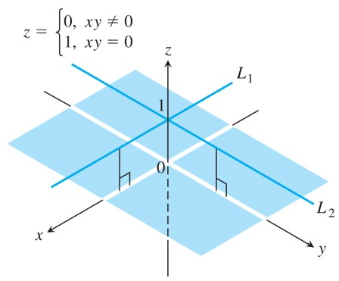
Partial Derivatives and Continuity (1 of 4)
The graph of
consists of the lines
(lying 1 unit
above the x y-plane) and the four open quadrants of the x y-plane. The function has partial derivatives at the origin but is not continuous there.
Notes:
Both the lines, L sub 1 and L sub 2, lie 1 unit above the x y plane and intersect at z = 1. If z = 0, x y does not equal 0 and if z = 1, x y = 0.

Slide 19
Partial Derivatives and Continuity (2 of 4)
Example: Let
(a) Find the limit of f as (x, y) approaches (0, 0) along the line y = x.
(b) Find the limit of f as (x, y) approaches (0, 0) along the line y = 0.
(c) Prove that f is not continuous at the origin.
(d) Show that both partial derivatives
exist at the origin.

Slide 20
Partial Derivatives and Continuity (3 of 4)
Solution:
(a) Since
is constantly zero along the line y = x
(except at the origin), we have
(b) Since
takes the constant value 1 at every point on the
line y = 0, we have.

Slide 21
Partial Derivatives and Continuity (4 of 4)
Solution (concluded):
(c) By the two-path test, f has no limit as (x, y) approaches (0, 0). Consequently, f is not continuous at (0, 0).
(d) To find
at (0, 0), we hold y fixed at y = 0. Then
for all x, and the graph of f is the line
The slope of this line at any x is
In particular,
at (0, 0). Similarly,
is the slope of line
at any y, so
at (0, 0).

Slide 22
Second-Order Partial Derivatives (1 of 2)
Example: If
find the second-
order derivatives
Solution: The first step is to calculate both first partial derivatives.

Slide 23
Second-Order Partial Derivatives (2 of 2)
Solution (concluded):
Now we find both partial derivatives of each first partial:

Slide 24
The Mixed Derivative Theorem (1 of 2)
Theorem—The Mixed Derivative Theorem
If
and its partial derivatives
and
are defined throughout an open region containing a
point (a, b) and are all continuous at (a, b), then

Slide 25
The Mixed Derivative Theorem (2 of 2)
Example: Find
Solution: If we interchange the order of differentiation and differentiate first with respect to x we get the answer more quickly. In two steps,
If we differentiate first with respect to y, we obtain
as well. We can differentiate in either order.

Slide 26
Partial Derivatives of Still Higher Order
Example: Find
Solution: We first differentiate with respect to the variable y, then x, then y again, and finally with respect to z:

Slide 27
Differentiability (1 of 4)
Definition: A function
is differentiable at
exist and
satisfies an
equation of the form
in which each of
as both
We call f differentiable if it is differentiable at every point in its domain, and say that its graph is a smooth surface.

Slide 28
Differentiability (2 of 4)
Theorem—The Increment Theorem for Functions of Two Variables
Suppose that the first partial derivatives of
are defined
throughout an open region R containing the point
and that
are continuous at
Then the change
in the value of f that results from moving from
to another point
in R satisfies an equation
of the form
in which each of
as both

Slide 29
Differentiability (3 of 4)
Corollary
If the partial derivatives
of a function
are continuous throughout an open region
R, then f is differentiable at every point of R.

Slide 30
Differentiability (4 of 4)
Theorem—Differentiability Implies Continuity
If a function
is differentiable at
then f is continuous at

Slide 31

Copyright
This work is protected by United States copyright laws and is provided solely for the use of instructors in teaching their courses and assessing student learning. Dissemination or sale of any part of this work (including on the World Wide Web) will destroy the integrity of the work and is not permitted. The work and materials from it should never be made available to students except by instructors using the accompanying text in their classes. All recipients of this work are expected to abide by these restrictions and to honor the intended pedagogical purposes and the needs of other instructors who rely on these materials.

